Slide 1
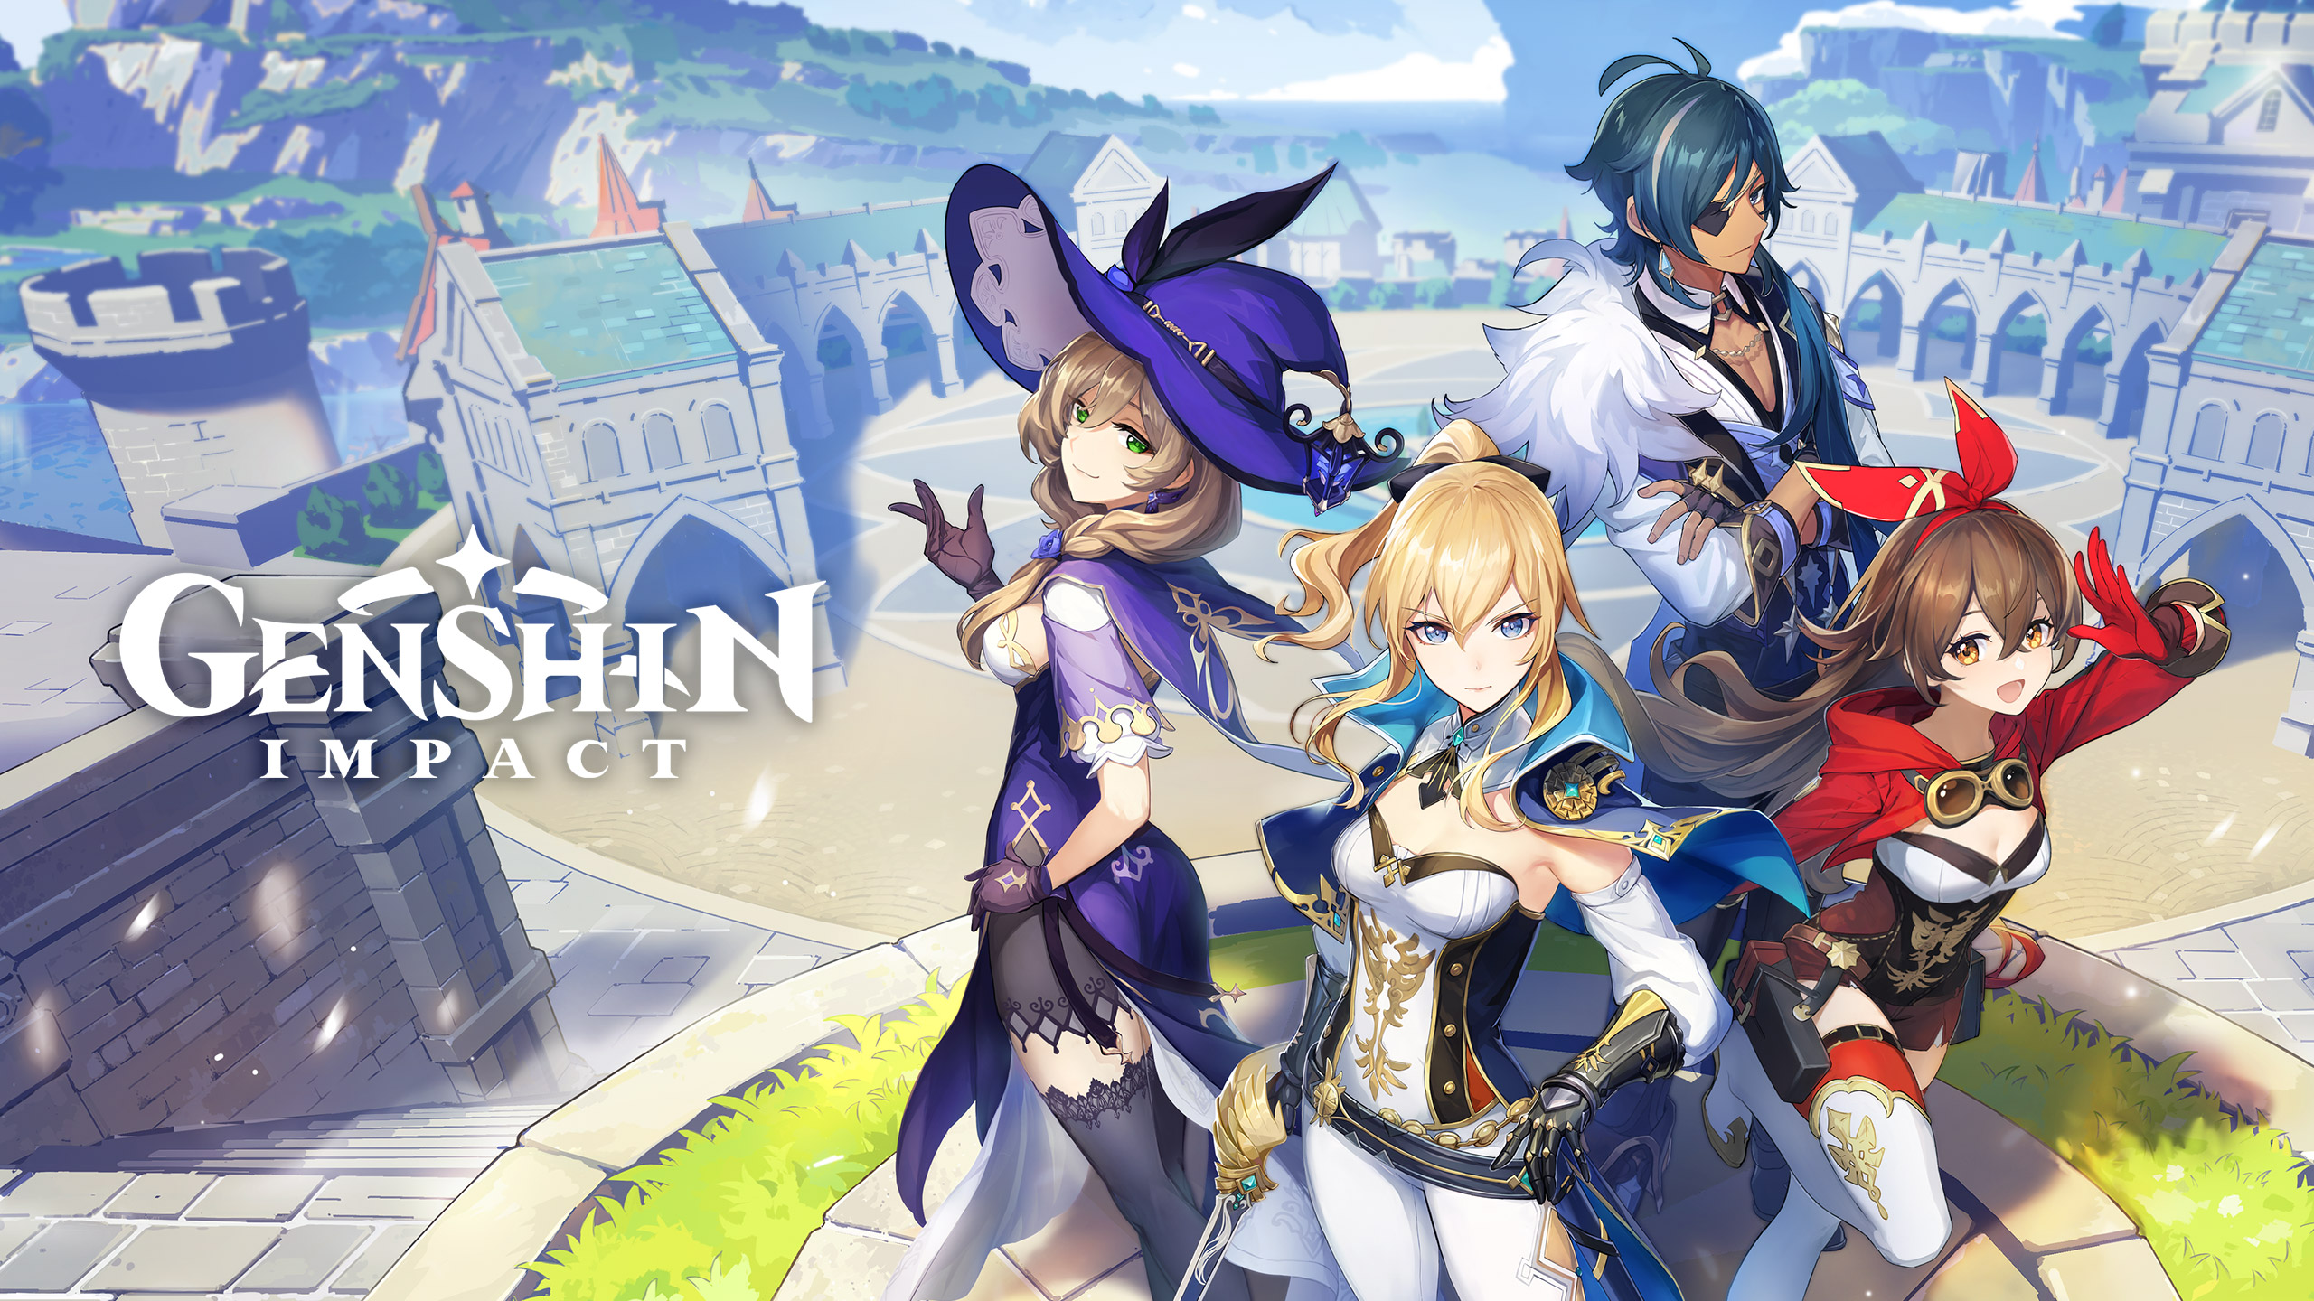
GAME

Slide 2
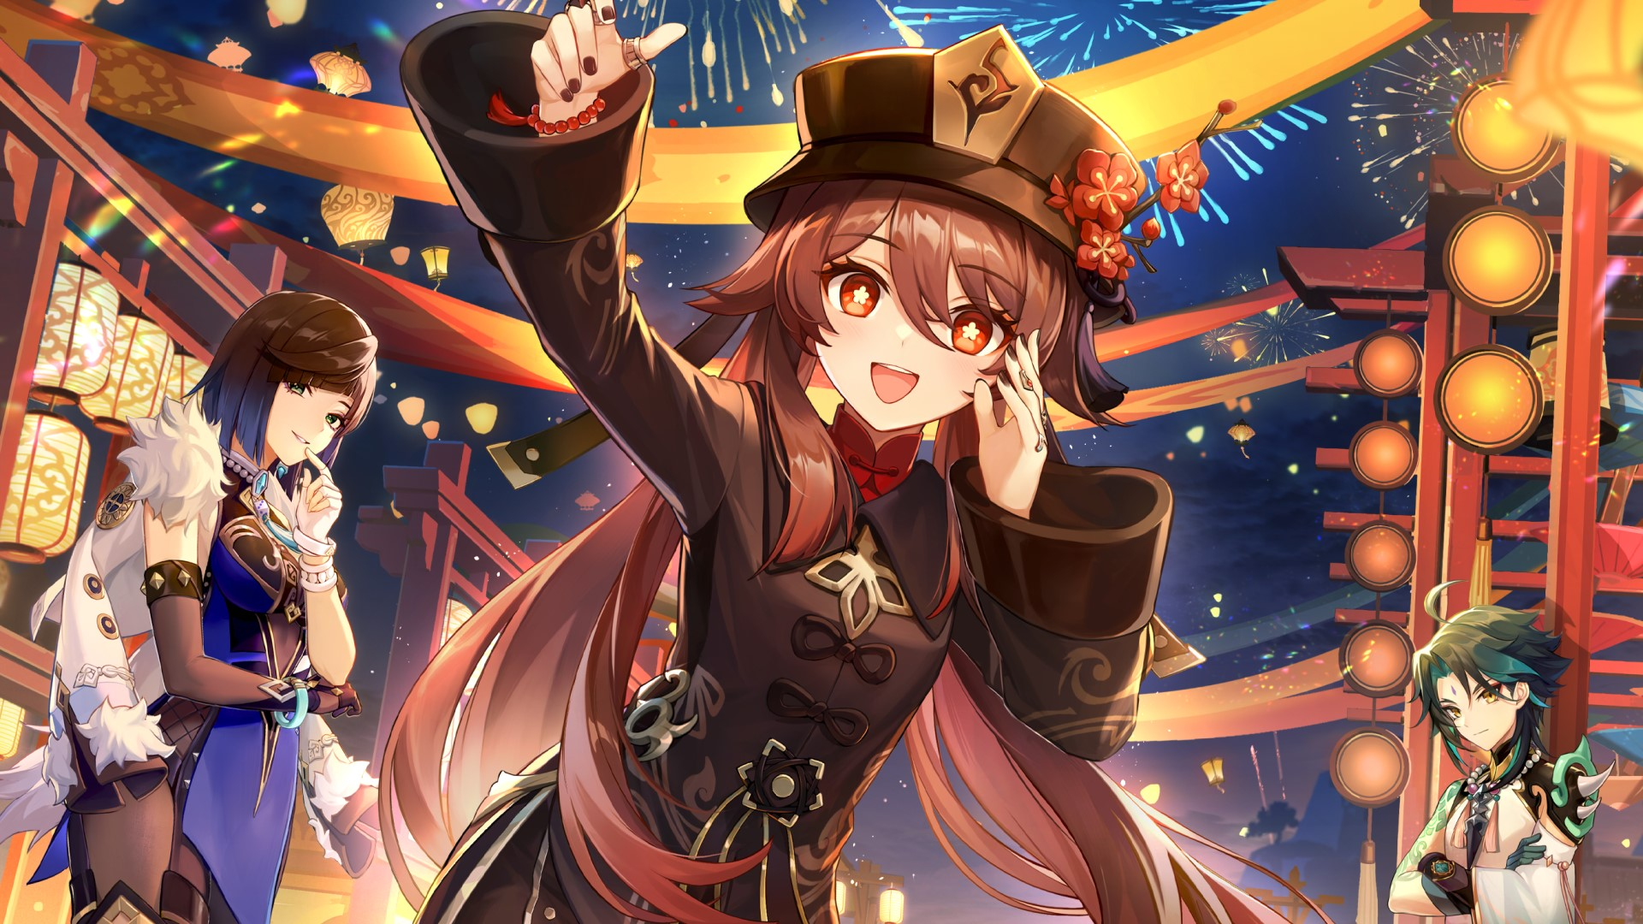
Goal of the game
Genshin is an online role—playing adventure game in the open world. This means that the player controls a character who can go to any corner of the game world from the start. Here you can play with other people — but only with their permission. There are no levels and other conventions in the game that would constantly limit. You can choose your own pace of passing and in general what to do.
The game world is big, and you can find a lot of different activities in it. For example, collect resources, communicate with city residents, complete tasks, fight monsters, solve riddles. At the same time, the creators added the main plot — a series of missions that can be gradually completed in order to learn more about the world and its main characters.

Slide 3
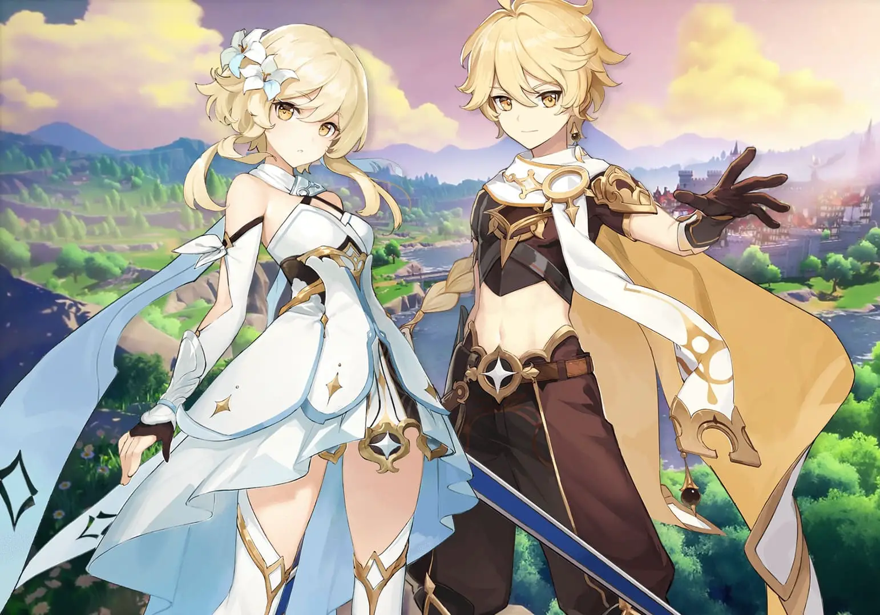
The main character and his abilities
At the very beginning, the player is offered to choose who he will play for. There are two options: traveler Iter or Lumin — brother or sister. These are twins who travel between worlds, but are forced to stay in Teivat — this is the name of the Genshin game world. After choosing a character, another sibling is kidnapped in the first scene — and the player must find him.

Slide 4
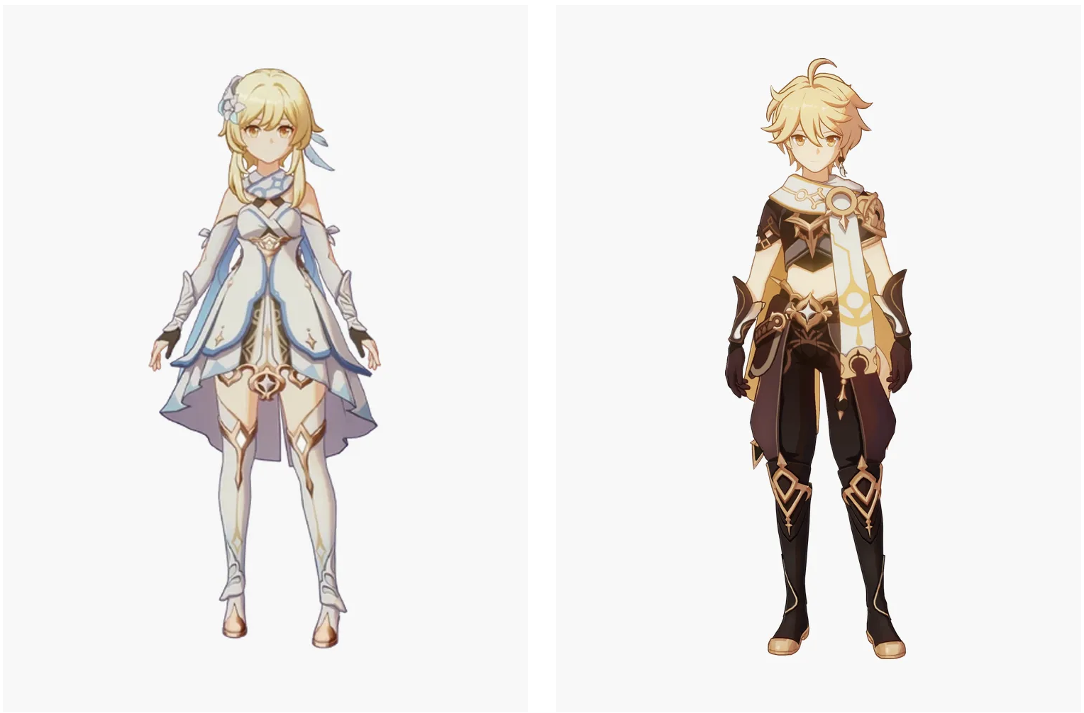
They look like the heroes of a typical anime.

Slide 5
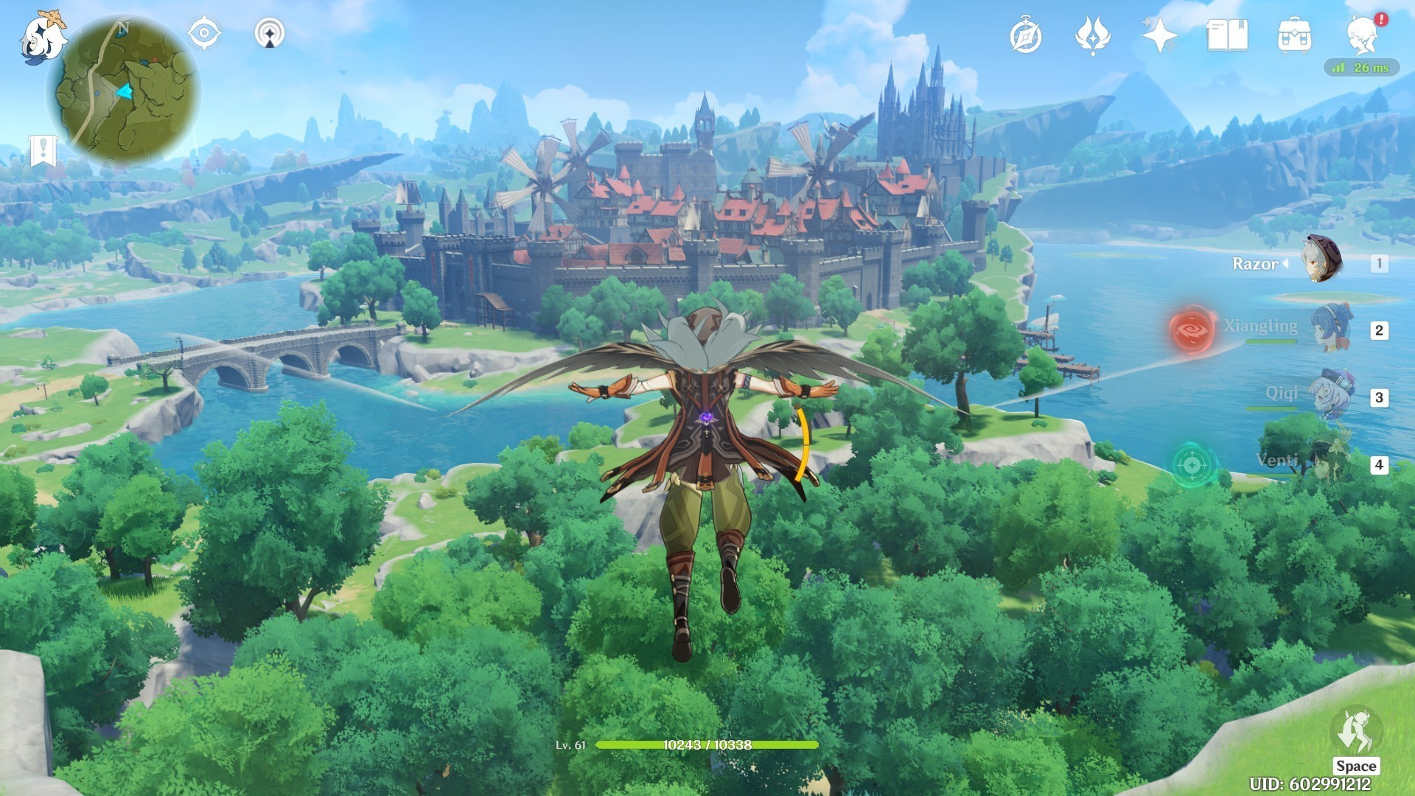
Specific features/characteristics
Each character has its own story and personality, which makes the game more interesting and exciting.

Slide 6
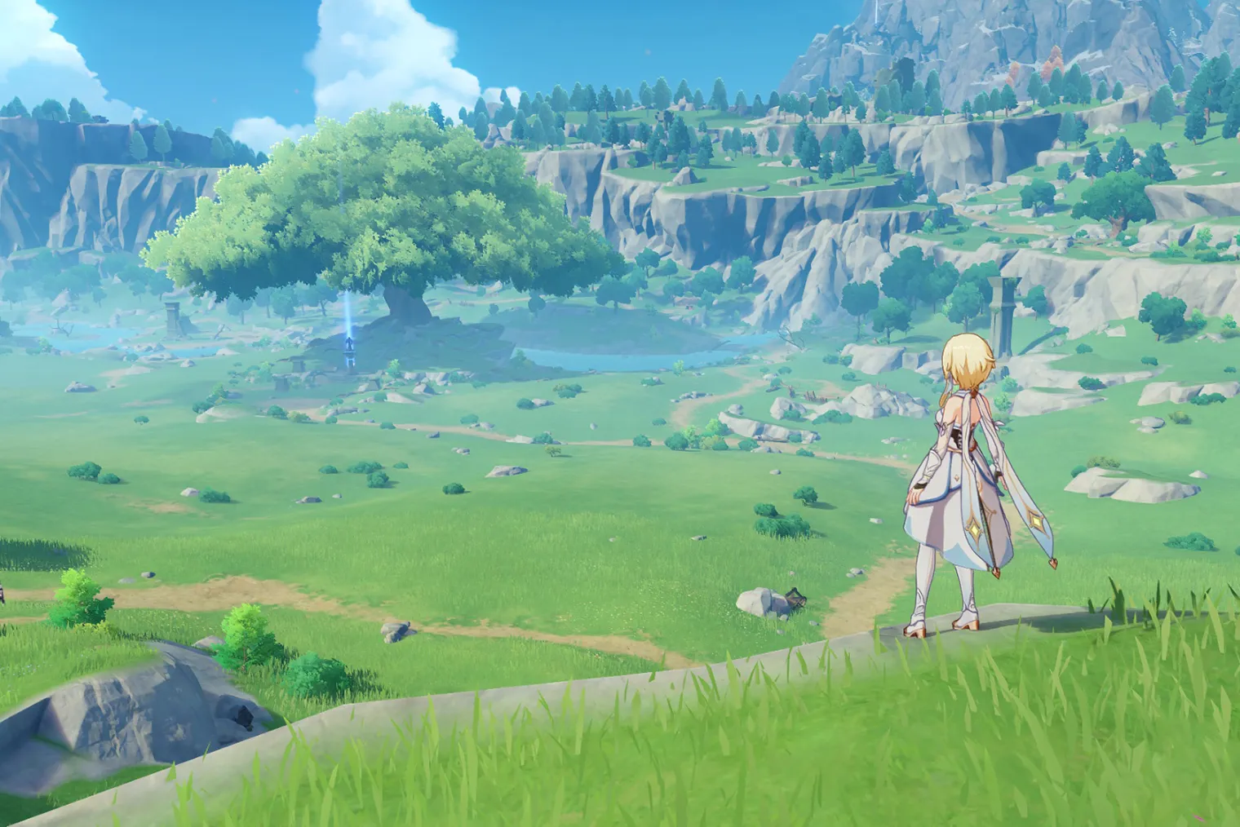
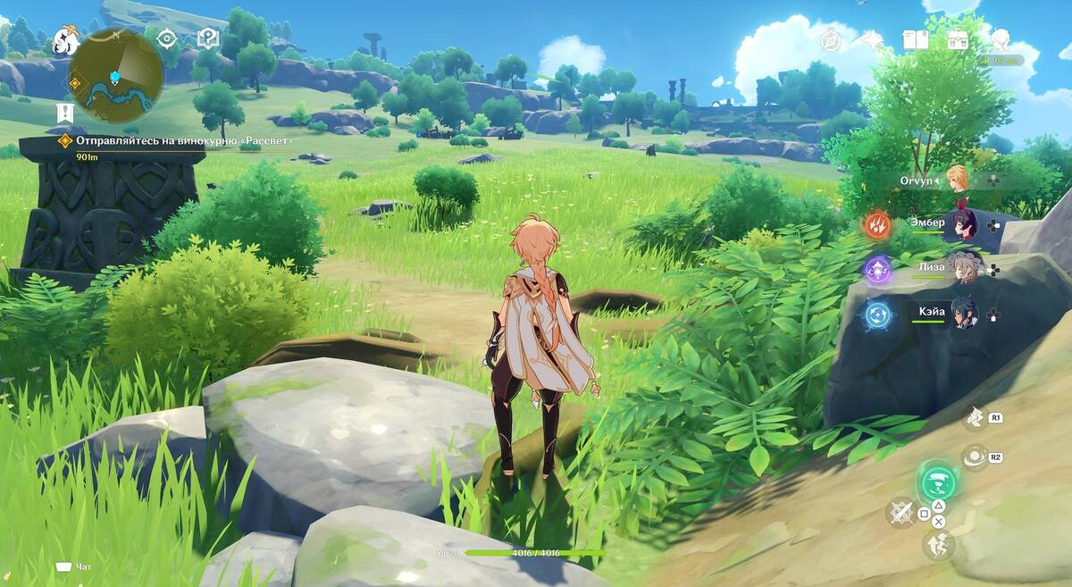
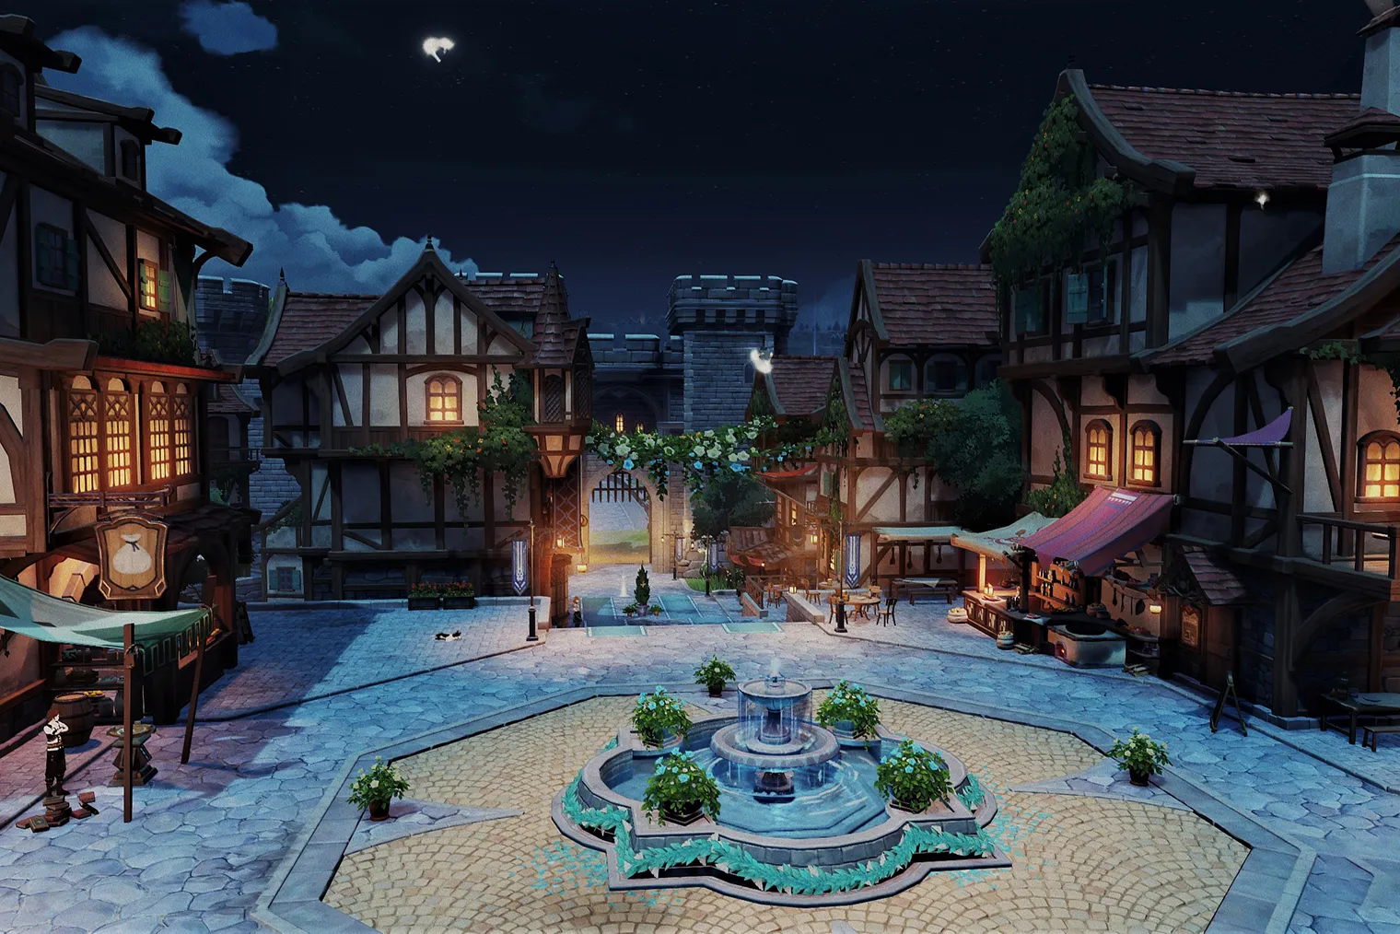
Graphics
The graphics in Genshin Impact are simply amazing. The developers have created a colorful and detailed world that completely immerses players in the gameplay.

Slide 7
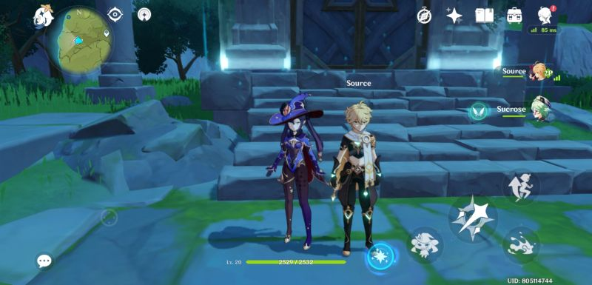
Multiplayer mode
Genshin Impact also has a multiplayer mode that allows players to team up with other players to fight bosses and complete tasks together.

Slide 8
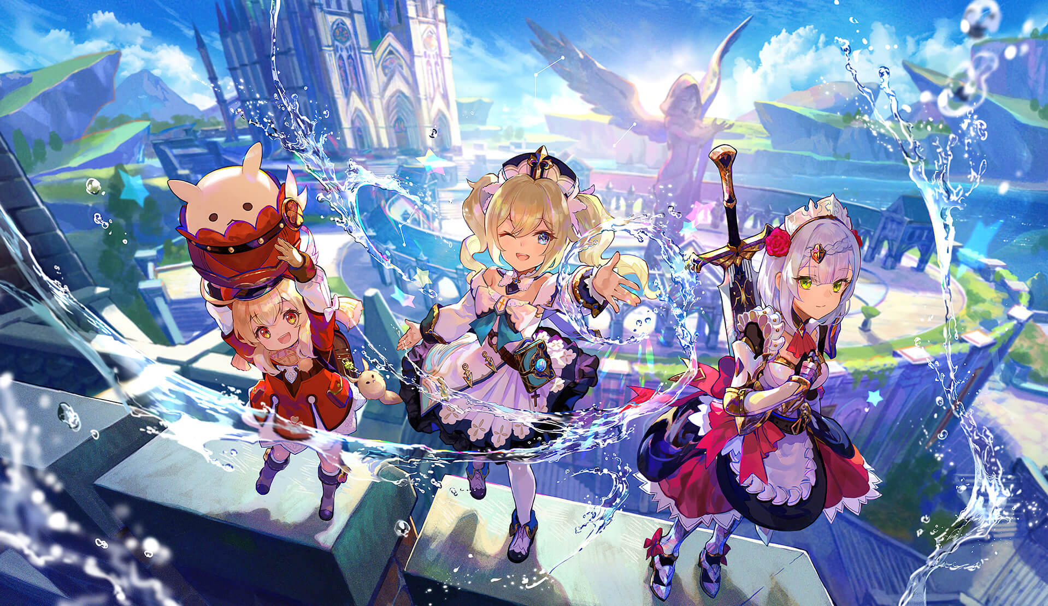
Who will be interested in this game?
Genshin Impact game is suitable for an open-world RPG lover who appreciates beautiful graphics and pejorative appearance. The game may also be of interest to those who like multiplayer modes and joint completion of tasks.

Slide 9
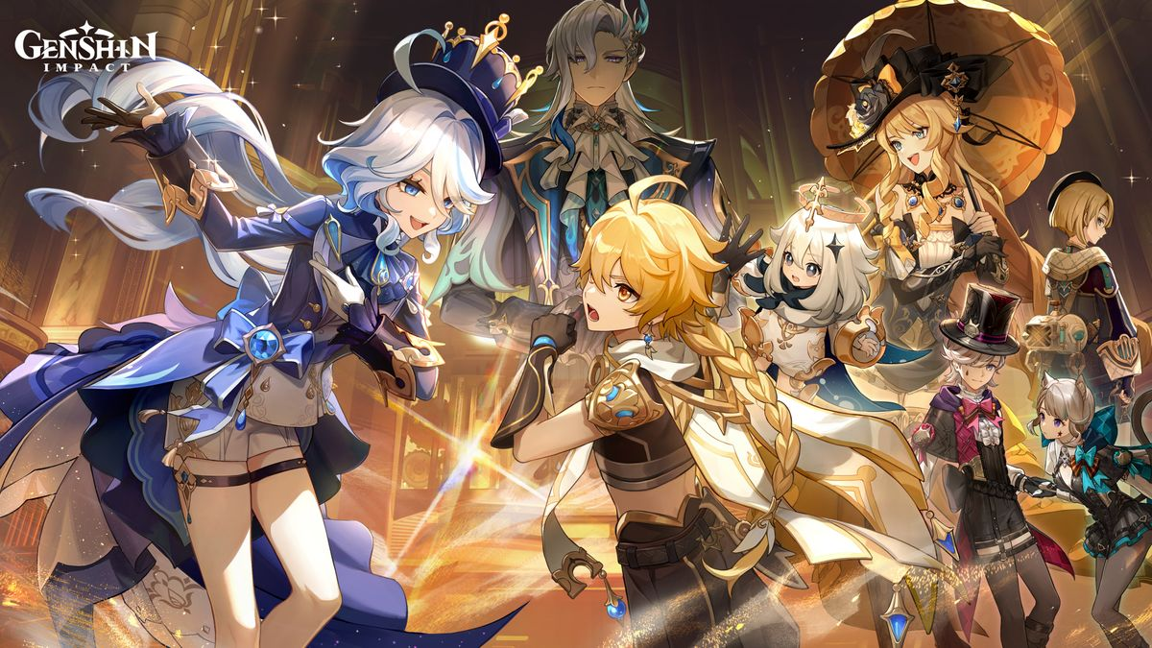
Conclusion
In general, Genshin Impact is an exciting game that is definitely worth your attention. It has everything you need to become the next cult game. If you haven't played Genshin Impact yet, then we strongly recommend you to try it!

